Slide 1
Analysis of Via Facilis student data
Key Takeaways
Students improved at Latin throughout the program
Improvement at Latin is positively correlated with academic attainment
Latin language ability has a strong positive correlation with metalinguistic ability
More to consider
Sample size was large enough to draw statistically significant conclusions, but more data would add reliability
Avoided comparing across years, focused on 22/23 data
Control group data would help to draw stronger conclusions

Slide 2
Interpreting results
R²
The R² value is a statistical measure that represents the proportion of the variance in the dependent variable that can be explained by the independent variable.
In social sciences, an R² value greater than 0.5 is considered “strong” because there are a wide range of factors influencing any given variable.
P
The P value is the probability of obtaining the given result if there was no relationship between the two variables.
A P value of less than 0.05 is a strong reason to believe there is a relationship between the two variables.

Slide 3
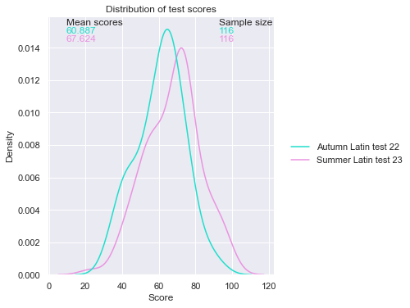
Latin Improvement
The cohort average improved on the second test
The program improves the Latin ability of the students
Percentage of students who achieved the score

Slide 4
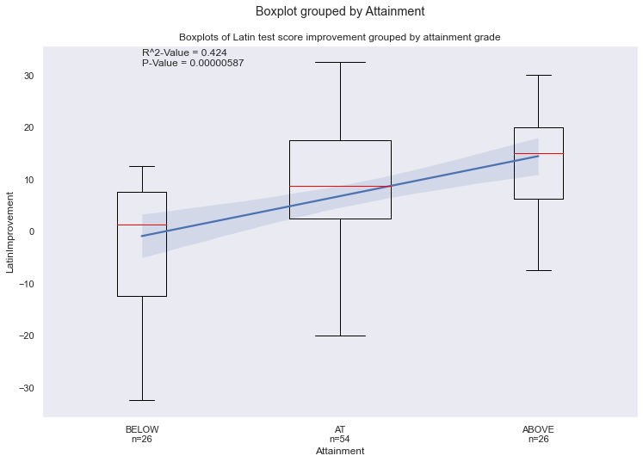
Latin’s relationship with Attainment
42% of the variation in attainment grades can be explained by improvement at Latin
Students who made greater improvements at Latin were more likely to receive a higher attainment grade for that year
This could mean that studying Latin has a positive impact on general academic attainment
However, we cannot rule out other possibilities such as students who studied more improved at Latin and in general
{
Half of the students who achieved this grade had scores in this range
Highest, median and lowest scores for students who achieved this grade
Improvement in score from Autumn 22 test to Summer 23 test

Slide 5
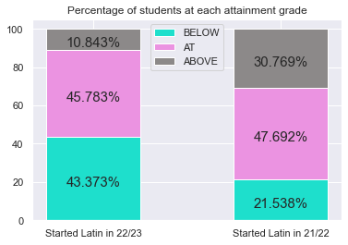
Without data from students with no experience studying Latin, we are not able to definitively assess Latin’s impact on attainment
However, this graph shows that students who had been studying Latin for longer typically received higher attainment grades.
Again, this could mean that studying Latin has a positive impact on general academic attainment, but other factors could be at play e.g., students who started in 22/23 had recently transferred to a new school and thus struggled more

Slide 6
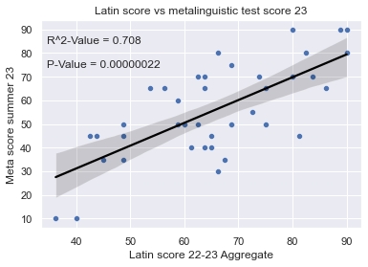
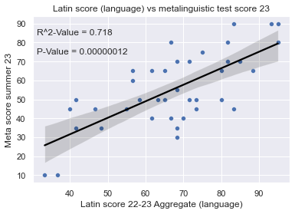
Metalinguistic Ability
Students who performed well in Latin were more likely to perform well in the Metalinguistic tests.
Performance on solely the language section of the test had a stronger correlation with metalinguistic test performance.
This could mean that studying Latin, particularly language, improves metalinguistic ability.
However, we cannot rule out other possibilities such as the students pre-existing linguistic ability determining their score on both tests.

Slide 7
How could we draw more definite conclusions?
To directly show how the students have benefitted, we would need similar data for a control group who had not taken part in the program.
Such as:
Students who did not participate in the program
Historical performance of the school
Results from similar schools
Future performance of students (non-participants and former participants)

